Slide 1
Internet of Things: Software Defined Radios
John L. Manferdelli
johnmanferdelli@hotmail.com
April 6, 2020, 14:30

Slide 2
Software defined radio, part 1, radios, spectrum and modulation
Radio and transmission lines
Spectrum
Modulation

Slide 3
Radio and transmission lines
Accelerating charges generate travelling waves of electric and magnetic fields in accordance with Maxwell’s equations (“EM waves”). These waves travel at the speed of light (in a vacuum) and their intensity drops off linearly rather than on the square of the distance.
Waves can travel wirelessly and be distributed radially (isotropically) from a source or an-isotropically (using, say, a parabolic antenna) so the majority of the energy travels in preferential directions. These waves can also travel in a waveguide like a coaxial cable or twisted pair.
Waves that carry information (music, images, digital bit streams) consist of a carrier wave which is constant frequency mixed with or modulated by a signal source that represents information (like a Paul Simon song). We call these waves radio waves.
Modulated, information bearing waves are produced by a transmitter and transmitted through an antenna then received by another antenna, amplified and demodulated at a receiver. The receiver selects (approximately) the right frequency bearing signal, demodulates it and rejects the rest of the spectrum. It’s a miracle.
Light is also an EM wave and everything we do with “radio frequency” waves has a much higher optical frequency analog.

Slide 4
Spectrum
Figure from Wikipedia
The spectrum of commonly used EM waves is picture on the right.
In all cases, f 𝜆= c, the speed of light. 𝜔 = 2𝛑 f. 𝜔 is called the angular frequency.
We will be exploring radio transmission for “AM” of frequency around a megahertz (MHz) and “FM” waves around 100 MHz.
IoT devices, transmitting at less than .25 watts of power, as well as your wireless router, employ unlicensed spectrum at:
2.4 gigahertz (GHz) – three channel, B, G, and N, and
5GHz, 23 channels, A, N, and AC.
933 MHz for toy controllers and off-net IoT radios
Transmission characteristics vary with frequency
A Wireless-A device that runs on at 5 GHz can support a maximum data rate of up to 54 Mbps.
Routers employ a very efficient and error tolerant modulation scheme called Orthogonal Frequency Division Multiplexing (OFDM).

Slide 5
Modulators and demodulators
A mixer is an electronic circuit that “multiplies” two signals: a carrier at angular frequency 𝝎_{c} and an information signal (say a pure tone) at angular frequency 𝝎_{m}.
By “multiplying” these, we get a modulated wave:
cos(𝝎_{c}t) cos(𝝎_{m}t)= ½ [cos(𝝎_{c}t+𝝎_{m}t) + cos(𝝎_{c}t-𝝎_{m}t)]
When we have signals composed of multiple frequencies (like a Paul Simon song), they combine linearly so the same equations hold in superposition.
A demodulator combines a (known) carrier with the received, modulated wave to recover the information signal.
cos(𝝎_{c}t+𝝎_{m}t) cos(𝝎_{c}t) = ½ [cos(2𝝎_{c}t+𝝎_{m}t) + cos(𝝎_{m}t)]
A filter then rejects the much higher frequency component cos(2𝝎_{c}t+𝝎_{m}t) to give the original information signal cos(𝝎_{m}t).
When signals are received, they are very weak but circuits know as amplifiers increase their power.
Like I said, it’s a miracle.

Slide 6
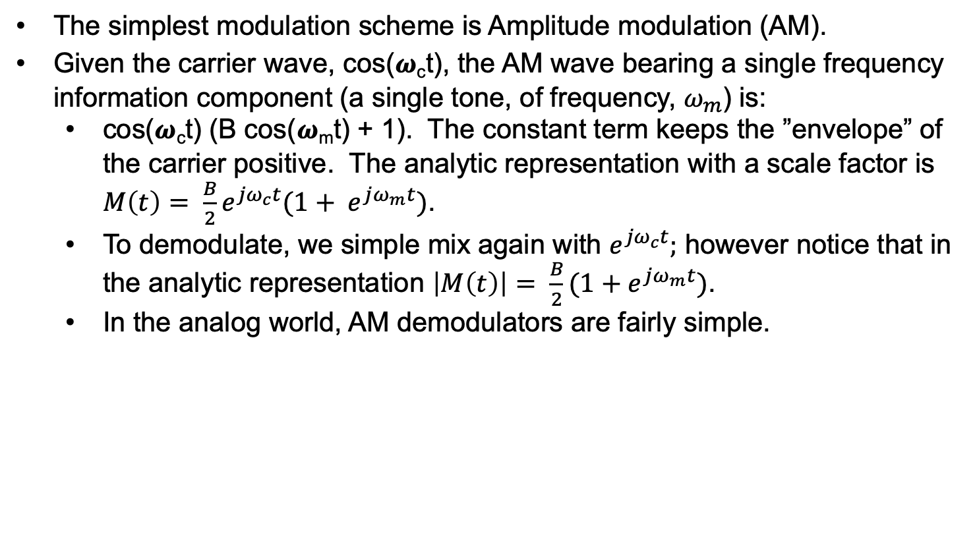
AM
The simplest modulation scheme is Amplitude modulation (AM).
Given the carrier wave, cos(𝝎_{c}t), the AM wave bearing a single frequency information component (a single tone, of frequency, $ω_{m}$) is:
cos(𝝎_{c}t) (B cos(𝝎_{m}t) + 1). The constant term keeps the ”envelope” of the carrier positive. The analytic representation with a scale factor is ${M\left(t\right)= \frac{B}{2}e}^{{jω}_{c}t}(1+ e^{jω_{m}t})$.
To demodulate, we simple mix again with $e^{{jω}_{c}t};$ however notice that in the analytic representation $\left|M\left(t\right)\right|= \frac{B}{2}(1+e^{jω_{m}t})$.
In the analog world, AM demodulators are fairly simple.
Figure from https://www.physics-and-radio-electronics.com/blog/amplitude-modulation/
Analog AM Demodulator

Slide 7
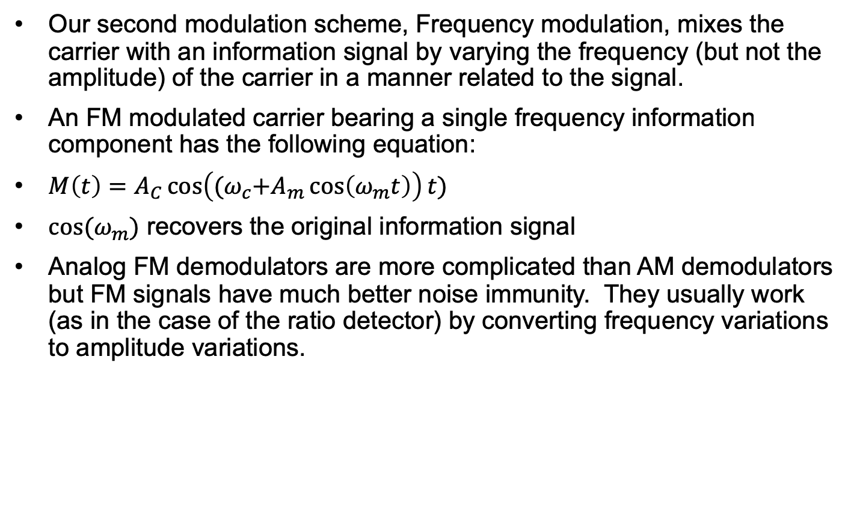
FM
Our second modulation scheme, Frequency modulation, mixes the carrier with an information signal by varying the frequency (but not the amplitude) of the carrier in a manner related to the signal.
An FM modulated carrier bearing a single frequency information component has the following equation:
$M\left(t\right)=A_{C}\cos\left({(ω}_{c}+A_{m}\cos\left(ω_{m}t\right)\right)t)$
$cos⁡(ω_{m})$ recovers the original information signal
Analog FM demodulators are more complicated than AM demodulators but FM signals have much better noise immunity. They usually work (as in the case of the ratio detector) by converting frequency variations to amplitude variations.
Figure from https://www.physics-and-radio-electronics.com/blog/frequency-modulation/
Analog FM Ratio Detector

Slide 8
Software defined radio, part 2, sinusoidal signals and representations
Oscillatory signals and Fourier analysis
Analytic signals
Noise, analytic signals and representing modulation
Sampling and aliasing
The frequency domain

Slide 9
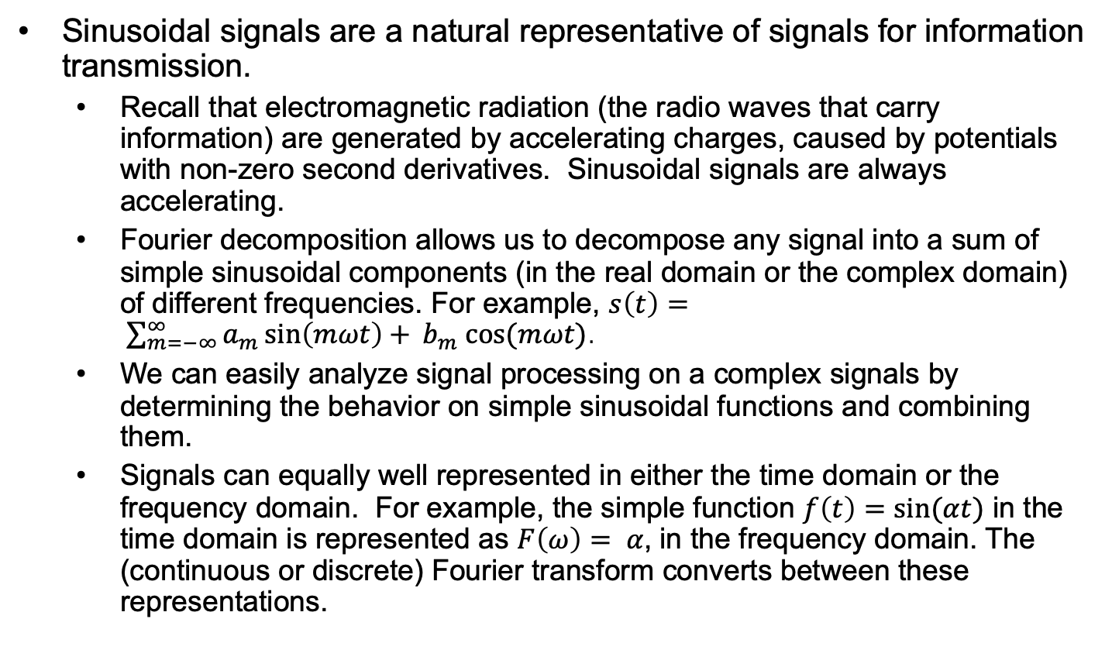
Oscillatory signals and Fourier analysis
Sinusoidal signals are a natural representative of signals for information transmission.
Recall that electromagnetic radiation (the radio waves that carry information) are generated by accelerating charges, caused by potentials with non-zero second derivatives. Sinusoidal signals are always accelerating.
Fourier decomposition allows us to decompose any signal into a sum of simple sinusoidal components (in the real domain or the complex domain) of different frequencies. For example, $s\left(t\right)= \sum_{m=−∞}^{∞}{a_{m}\sin\left(mωt\right)+ }b_{m} cos⁡(mωt)$.
We can easily analyze signal processing on a complex signals by determining the behavior on simple sinusoidal functions and combining them.
Signals can equally well represented in either the time domain or the frequency domain. For example, the simple function $f\left(t\right)=sin⁡(αt)$ in the time domain is represented as $F\left(ω\right)= α$, in the frequency domain. The (continuous or discrete) Fourier transform converts between these representations.

Slide 10
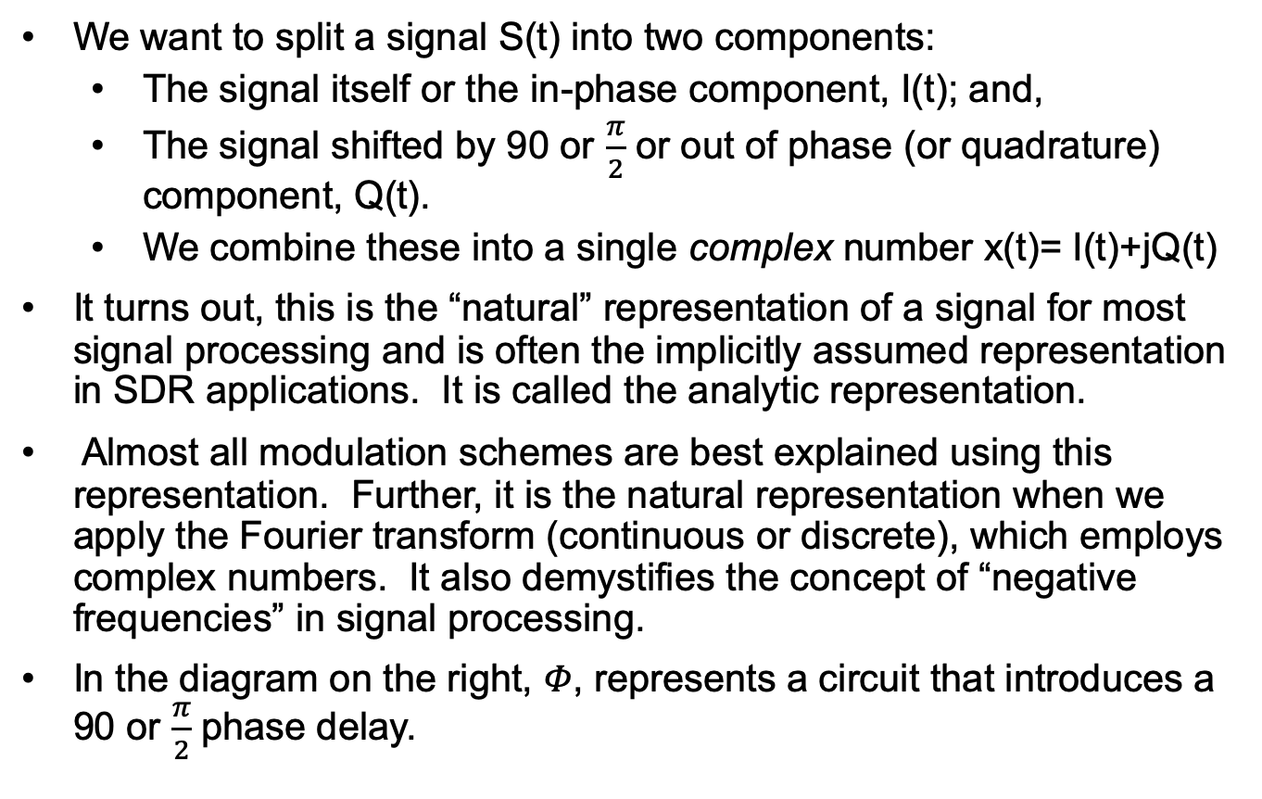
Analytic signal representation
We want to split a signal S(t) into two components:
The signal itself or the in-phase component, I(t); and,
The signal shifted by 90 or $\frac{π}{2}$ or out of phase (or quadrature) component, Q(t).
We combine these into a single complex number x(t)= I(t)+jQ(t)
It turns out, this is the “natural” representation of a signal for most signal processing and is often the implicitly assumed representation in SDR applications. It is called the analytic representation.
Almost all modulation schemes are best explained using this representation. Further, it is the natural representation when we apply the Fourier transform (continuous or discrete), which employs complex numbers. It also demystifies the concept of “negative frequencies” in signal processing.
In the diagram on the right, 𝛷, represents a circuit that introduces a 90 or $\frac{π}{2}$ phase delay.
Q(t)
𝜱
S(t)
∼
I(t)

Slide 11
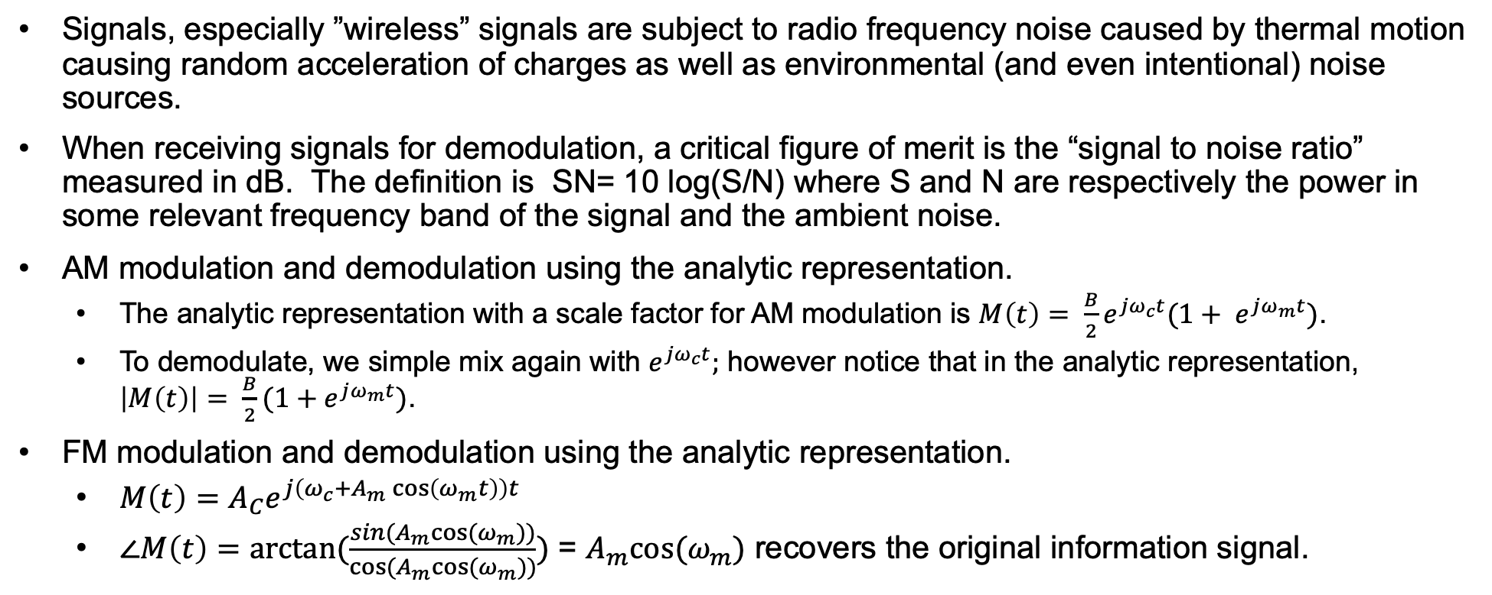
Noise, analytic signals and modulation
Signals, especially ”wireless” signals are subject to radio frequency noise caused by thermal motion causing random acceleration of charges as well as environmental (and even intentional) noise sources.
When receiving signals for demodulation, a critical figure of merit is the “signal to noise ratio” measured in dB. The definition is SN= 10 log(S/N) where S and N are respectively the power in some relevant frequency band of the signal and the ambient noise.
AM modulation and demodulation using the analytic representation.
The analytic representation with a scale factor for AM modulation is ${M\left(t\right)= \frac{B}{2}e}^{{jω}_{c}t}(1+ e^{jω_{m}t})$.
To demodulate, we simple mix again with $e^{{jω}_{c}t};$ however notice that in the analytic representation, $\left|M\left(t\right)\right|= \frac{B}{2}(1+e^{jω_{m}t})$.
FM modulation and demodulation using the analytic representation.
$M\left(t\right)=A_{C}e^{j\left(ω_{c}+A_{m}\cos\left(ω_{m}t\right)\right)t}$
$∠M\left(t\right)=arctan⁡(\frac{sin(A_{m}cos⁡(ω_{m}))}{cos⁡(A_{m}cos⁡(ω_{m}))})$ = $A_{m}cos⁡(ω_{m})$ recovers the original information signal.

Slide 12
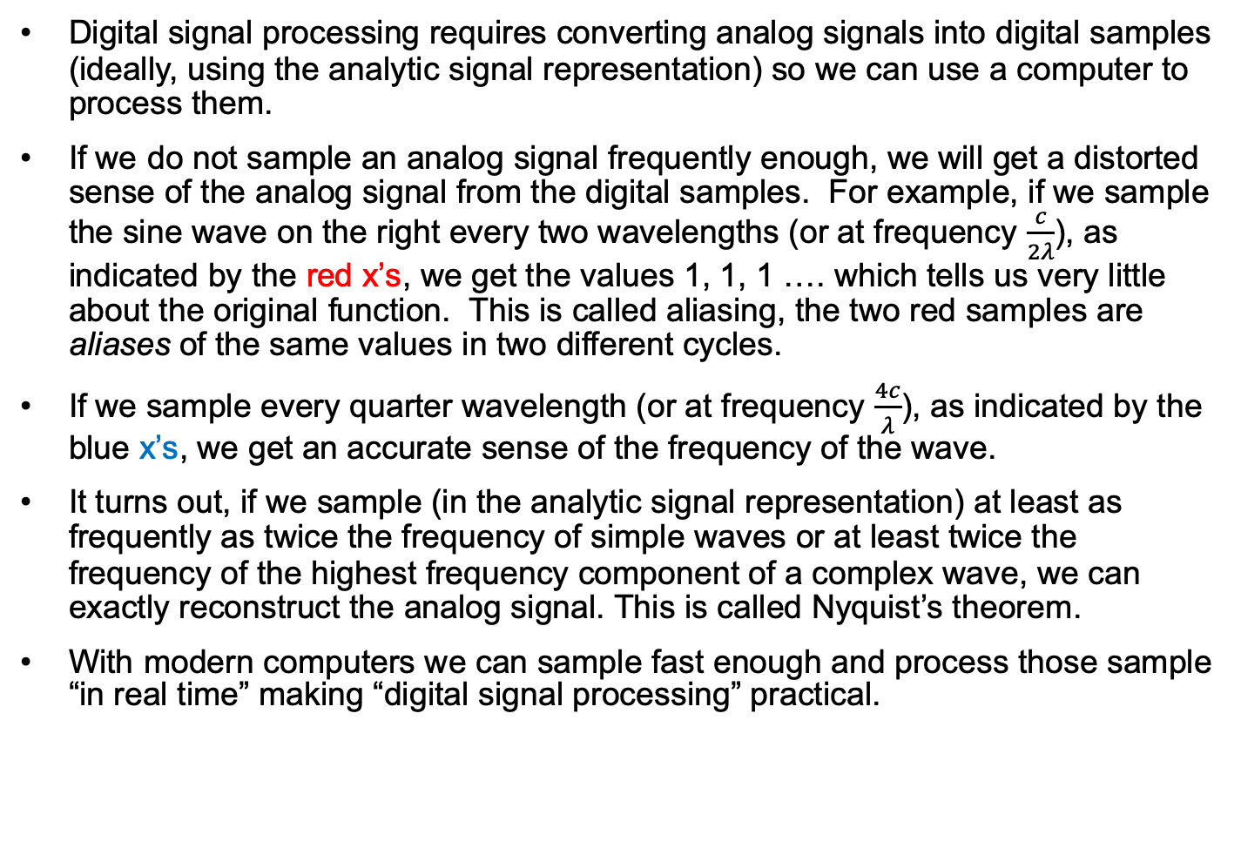
Sampling and aliasing
Digital signal processing requires converting analog signals into digital samples (ideally, using the analytic signal representation) so we can use a computer to process them.
If we do not sample an analog signal frequently enough, we will get a distorted sense of the analog signal from the digital samples. For example, if we sample the sine wave on the right every two wavelengths (or at frequency $\frac{c}{2λ}$), as indicated by the red x’s, we get the values 1, 1, 1 …. which tells us very little about the original function. This is called aliasing, the two red samples are aliases of the same values in two different cycles.
If we sample every quarter wavelength (or at frequency $\frac{4c}{λ}$), as indicated by the blue x’s, we get an accurate sense of the frequency of the wave.
It turns out, if we sample (in the analytic signal representation) at least as frequently as twice the frequency of simple waves or at least twice the frequency of the highest frequency component of a complex wave, we can exactly reconstruct the analog signal. This is called Nyquist’s theorem.
With modern computers we can sample fast enough and process those sample “in real time” making “digital signal processing” practical.
x
x
x
x
x
x
x
x
x
x
x
x

Slide 13
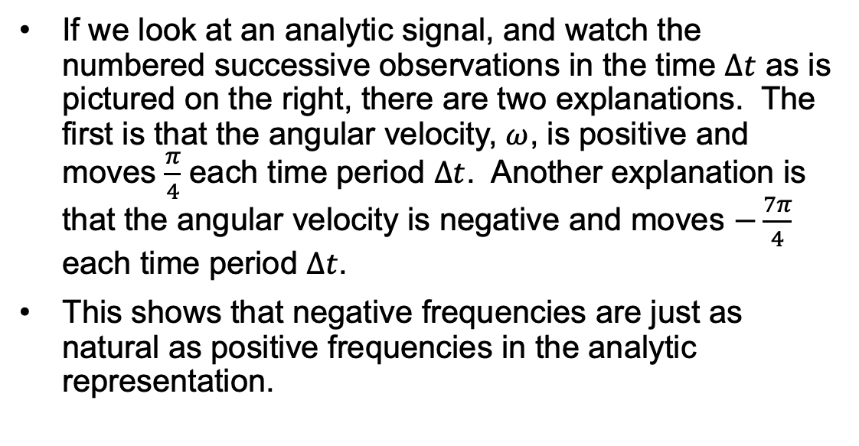
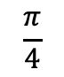
Negative frequency
2
If we look at an analytic signal, and watch the numbered successive observations in the time $∆t$ as is pictured on the right, there are two explanations. The first is that the angular velocity, $ω$, is positive and moves $\frac{π}{4}$ each time period $∆t$. Another explanation is that the angular velocity is negative and moves $−\frac{7π}{4}$ each time period $∆t$.
This shows that negative frequencies are just as natural as positive frequencies in the analytic representation.
3
1
4
$$\frac{π}{4}$$
8
5
7
6

Slide 14
Signal reconstruction
The idea of digital sampling is fairly intuitive. It is important, we discovered, before sampling to first low pass filter the incoming signal to avoid aliasing. The components that are used to sample analog signals are called A/D converters. They are fairly common parts that vary with respect to the sampling interval. To digitize high bandwidth signals, A/D converters should be very fast and ideally sample with high precision (16 to 24 bits).
Commercial A/D converter: ADC32RF45.
Reconstructing an analog signal from digital samples is the job of a D/A converter. They are slightly more complicated but fortunately, there are standard parts to do that as well.
Commercial D/A converter: D/A.
Simple D/A converter
Credit: Electronics course
ece.umd.edu

Slide 15
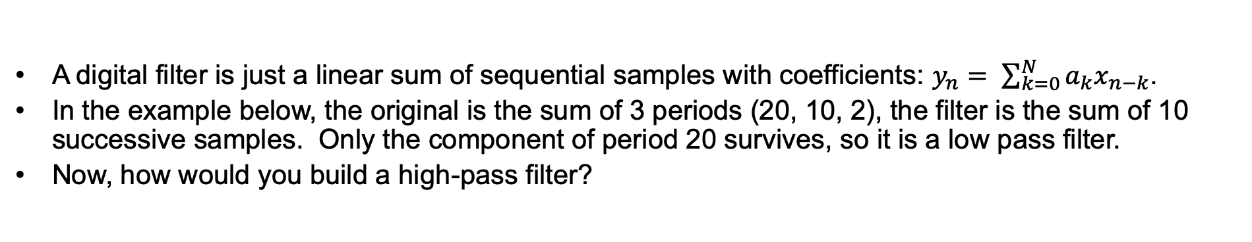
Digital Filters
A digital filter is just a linear sum of sequential samples with coefficients: $y_{n}= \sum_{k=0}^{N}{a_{k}x_{n−k}}$.
In the example below, the original is the sum of 3 periods (20, 10, 2), the filter is the sum of 10 successive samples. Only the component of period 20 survives, so it is a low pass filter.
Now, how would you build a high-pass filter?

Slide 16
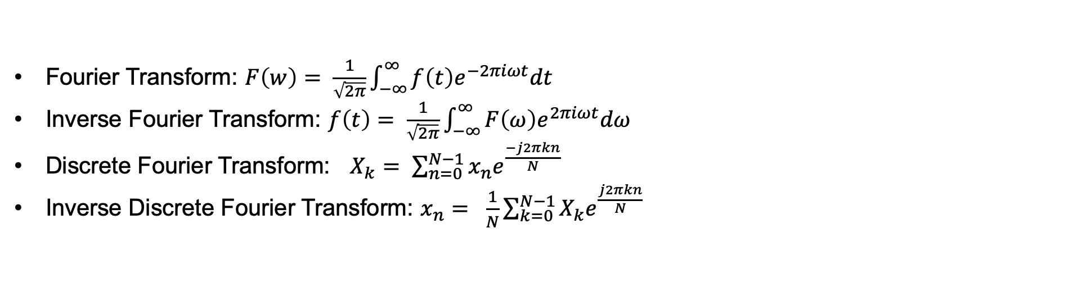
Fourier Transforms and the frequency domain
Fourier Transform: $F\left(w\right)= \frac{1}{\sqrt{2π}}\int_{−∞}^{∞}{f\left(t\right)e^{−2πiωt}dt}$
Inverse Fourier Transform: $f\left(t\right)= \frac{1}{\sqrt{2π}}\int_{−∞}^{∞}{F\left(ω\right)e^{2πiωt}dω}$
Discrete Fourier Transform: $X_{k}= \sum_{n=0}^{N−1}{x_{n}e^{\frac{−j2πkn}{N}}}$
Inverse Discrete Fourier Transform: $x_{n}= \frac{1}{N}\sum_{k=0}^{N−1}{X_{k}e^{\frac{j2πkn}{N}}}$
Graph of the real part of the original data set from previous page. Note peaks corresponding to the periods 20, 10, 2.

Slide 17
Working in the frequency domain
It is often easier to do some signal processing in the frequency domain. This is easily accomplished with digital signals, by performing a DFT (Discrete Fourier Transform). There are algorithms that do this efficiently.
Once we are in the digital domain some things that are difficult or impossible in the time domain can be done easily. For example, we can accurately choose the frequency band of a signal we are interested in by simply discarding frequency components outside the range of interest.
Complex processing like spread spectrum transmissions, frequency hopping and adaptive processing would not be practical without frequency domain processing.
The inverse discrete Fourier transform can be used after all frequency domain processing is completed to convert back into the time domain.

Slide 18
Software defined radio, part 3, what’s an SDR and how do you use it?
Components of a software defined radio
Analog front end
Digital sampling
Signal processing
Building blocks
GNU radio
AM, FM modulation and demodulation in a SDR
FSK
BSK

Slide 19
What’s an SDR?
S(t)
∼
An SDR is a signal processing subsystem end that takes, as input, a continuous analog signal and converts it into digital samples that can be processed.
An SDR also does the inverse, taking a time series of digital samples, resulting from some processing and turning those samples into the desired analog output.
As we discussed in previous slides, we need to do this with a clear understanding of aliasing so we can get accurate signal reconstruction.
An SDR can be used with a digital computer to perform the signal processing. The entire function of an SDR/processor combination can be changed entirely by changing software. Digital samples are easy to process with “perfect accuracy” and complete flexibility, unlike most analog circuits.
The picture on the right shows the components of half an SDR system.
Low or band pass filter
𝜱
A/D
A/D
I(t)
Q(t)

Slide 20
Building blocks
SDR processing uses program elements, often represented graphically, in blocks.
Common blocks include:
Oscillators
Multipliers
Adders
Filters
FFT/IFFT blocks
Modulators and demodulators
Blocks representing functions that sample or synthesize analog signals (A/D and D/A converters).
Virtual sources and sinks for simulating signals.

Slide 21
Gnu Radio
A very flexible and widely used tool to design and build these processing elements is GNU radio.
The GNU Radio Companion (GRC) is a graphical UI used to develop GNU Radio applications consisting of python code.
GNU Radio companion has an extensive library of components and works with SDR’s like HackRF One and USRP.
All our examples use GNU Radio Companion.
GRC UI on the right.
The “panel” on the right is list of categories of components that come with GRC like demodulators, adders, signal sources and sinks, SDR interfaces, FFT’s
From Wikipedia

Slide 22
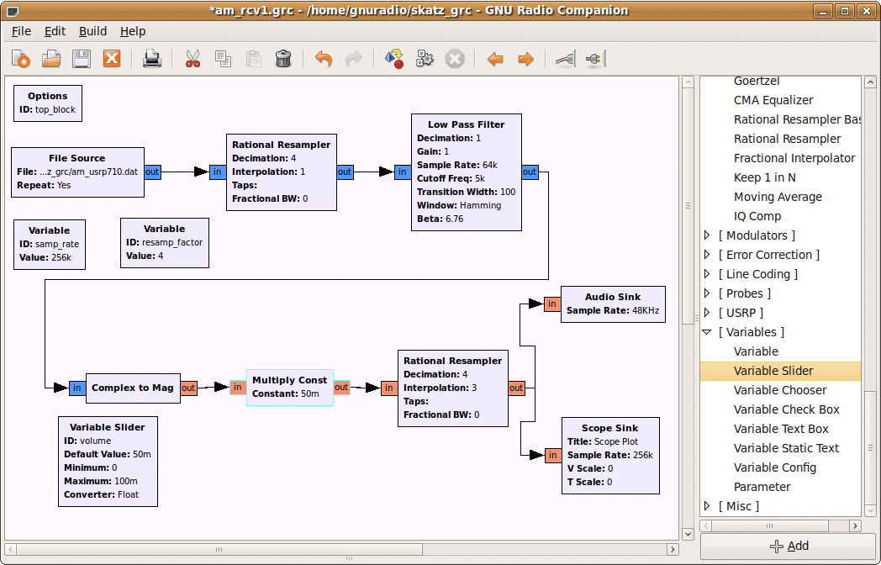
AM Demodulation in an SDR
Analog AM modulation is accomplished by simple mixing. Digital demodulation mirrors this. The demodulator on the right uses our observations earlier that taking the magnitude of the analytic representation of the AM signal decodes it.

Slide 23


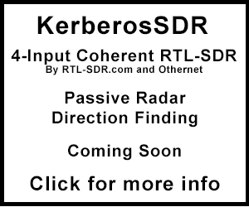




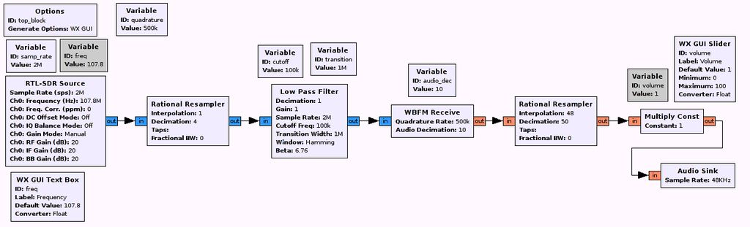

FM Demodulation in an SDR
Analog demodulation of FM usually proceeds by turning the FM signal into an AM signal and demodulating that in the usual way. Digital demodulation is a little different.
RTL-SDR.com

Slide 24
FSK Modulation
Frequency Shift Keying is a digital modulation technique.
0 and 1 are encoded by different frequencies each in sequential fixed time periods
Wikipedia

Slide 25
BFSK modulation
Binary Frequency Shift Keying (BFSK) modulates digital signals where 0 and 1 are represented by different frequencies.
Mathworks

Slide 26
BPSK modulation
Binary Phase Shift Keying (BSPK) modulates digital signals where 0 and 1 are represented by different phase states.
Mathworks

Slide 27
QPSK Modulation
Quadrature Phase Shift Keying (QPSK): Similar to BPSK but there are four subcarrier phases all with the same amplitude. There are 2 bits per symbol.
If we can choose amplitudes we can get more bits per symbol. This is Quadrature Amplitude Modulation (QAM).
From https://www.st-andrews.ac.uk/~www_pa/Scots_Guide/RadCom/part19/page2.html

Slide 28
Software defined radio, part 4, receiving, transmitting and decoding wireless router signals with SDR
OFDM
802.11

Slide 29
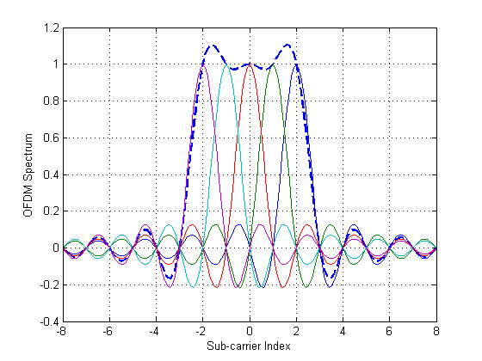
OFDM Modulation
Orthogonal Frequency Division Modulation encodes sequential digital bits on different carriers.
It is used in 802.11 and has both high bandwidth and good noise immunity.
Subcarriers are chosen to be orthogonal to each other (as in the analytic signal representation) and requires accurate frequency synchronization between transmitters and receivers.
It is significantly more complex than any of the other modulation techniques we’ve already seen.

Slide 30
Why OFDM?
Wireless signals can suffer from a number of distortions including selective fading (caused by absorption), frequency contention and multi-path distortion caused by the arrival of the same signal from two different paths.
ODFM is resistant to these distortions and, because it converts the serial data stream into several parallel streams, it is fast.
Unfortunately, we won’t go into the design details but you can check it out.

Slide 31
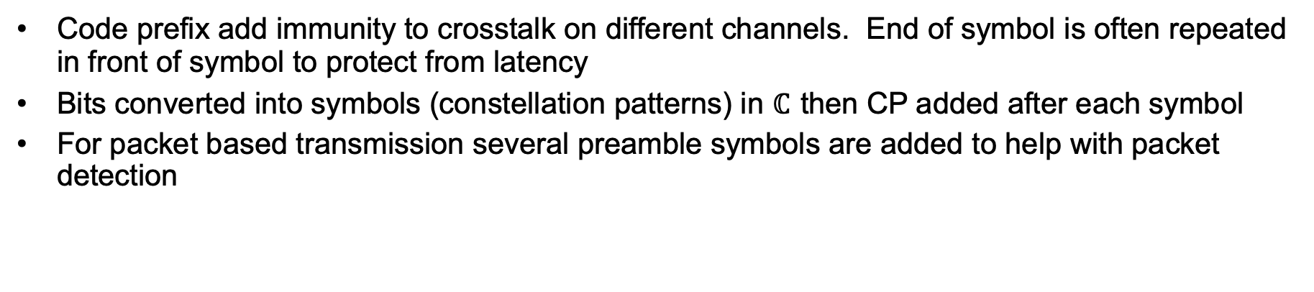
OFDM transmitter elements
Modulation
Serial-> parallel (S/P)
Insert cyclic
prefix
Data in
IFFT
P/S
Signal out
D/A
Code prefix add immunity to crosstalk on different channels. End of symbol is often repeated in front of symbol to protect from latency
Bits converted into symbols (constellation patterns) in $ℂ$ then CP added after each symbol
For packet based transmission several preamble symbols are added to help with packet detection

Slide 32
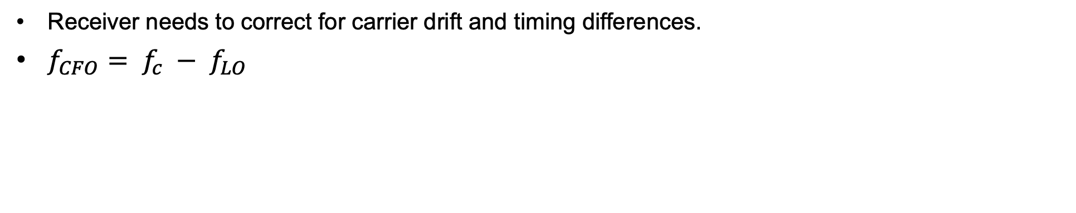
OFDM – receiver elements
Signal in
Correct CFO
S/P
Remove cyclic
prefix
FFT
D/A
Data out
Demodulation
P/S
Phase track
Receiver needs to correct for carrier drift and timing differences.
$f_{CFO}= f_{c} − f_{LO}$

Slide 33
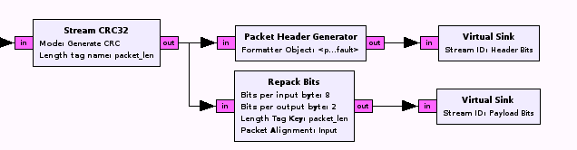
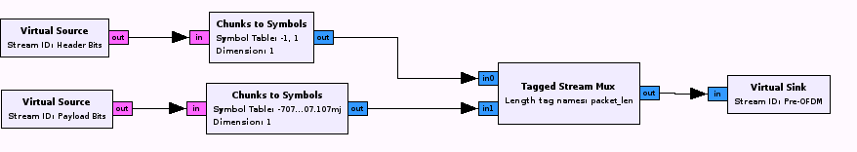
OFDM prefix codes and symbol mapping
Martin Braun
Generate cyclic prefix
Map bits to constellation symbols

Slide 34
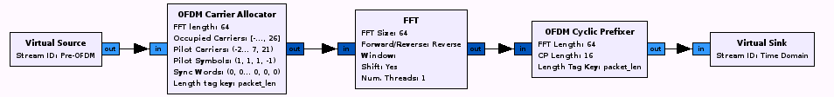
OFDM prefix codes
Gnu Radio
Allocate Carriers and add prefixes

Slide 35
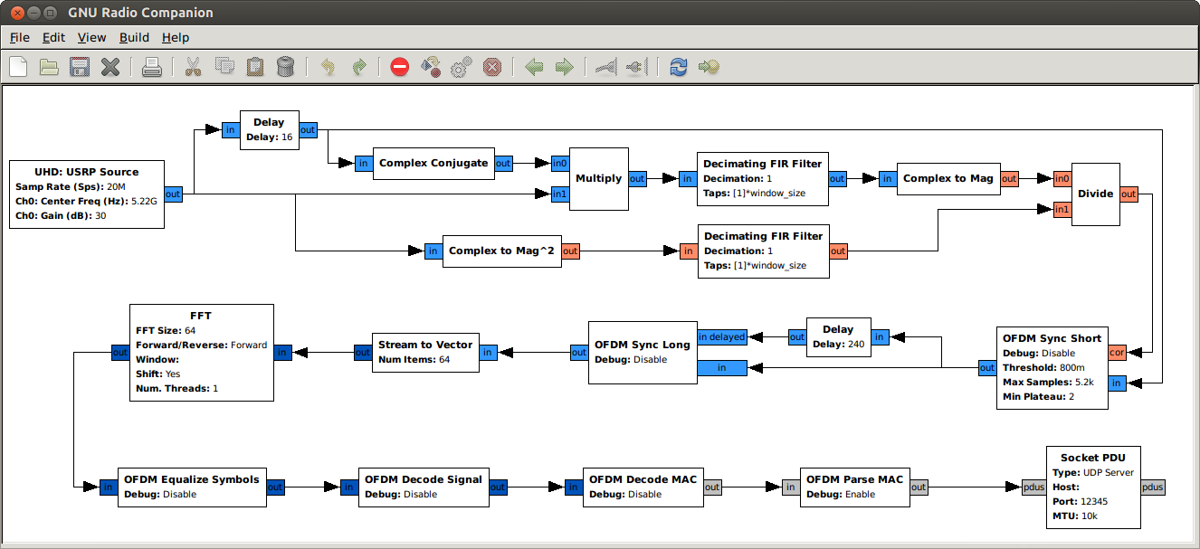
Gnu Radio OFDM Receiver
Frame detection
Frame decoding

Slide 36
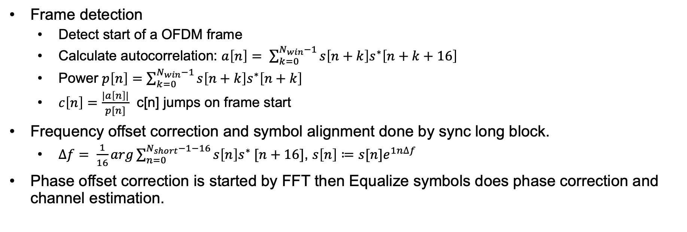
Notes on Gnu Radio OFDM receiver
Frame detection
Detect start of a OFDM frame
Calculate autocorrelation: $a\left[n\right]= \sum_{k=0}^{N_{win}−1}{s\left[n+k\right]s^{∗}\left[n+k+16\right] }$
Power $p\left[n\right]=\sum_{k=0}^{N_{win}−1}{s\left[n+k\right]s^{∗}\left[n+k\right] }$
$c\left[n\right]=\frac{|a\left[n\right]|}{p[n]}$ c[n] jumps on frame start
Frequency offset correction and symbol alignment done by sync long block.
$∆f= \frac{1}{16}arg\sum_{n=0}^{N_{short}−1−16}{s\left[n\right]s^{∗} [n+16]}$, $s\left[n\right]≔s[n]e^{1n∆f}$
Phase offset correction is started by FFT then Equalize symbols does phase correction and channel estimation.
From Bloess, Segata, Sommer and Dressler

Slide 37
Notes on Gnu Radio OFDM receiver
Signal Field decoding
Determines length and encoding of symbols
Frame decoding
Demodulate, demultiplex, descramble bit stream
Socket PDU is a UDP server.
This is the output sink consisting of UDP datagrams
Both BPSK and QPSK modulation are supported
Sample system uses Ettus N210 and VERT2450 (3dBi) antenna
From Bloess, Segata, Sommer and Dressler

Slide 38
Software defined radio, part 5, amplifiers, beam forming, jamming and SDR RF attacks
Direction finding
Signal loss
Jamming
Beam forming and steering
Attacking IoT devices

Slide 39
Directionality and steering
Not all radio transmissions are omnidirectional.
Dipole antennas transmit preferentially in the direction perpendicular to the surface of a cylinder enclosing the dipole wire and not in the third direction, perpendicular to the “caps” of the cylinder. Ground effects distort this geometry.
Parabolic antennas are highly directional and have gains around 60 dB. A 2 meter parabolic dish has a beam width of about 2.6 degrees around 10 GHz.
You can transmit (or receive) over several physically separated antennas (of any type) and use superposition to produce a highly directional transmission or reception patterns as phased array antennas do.
In many applications, signal characteristics, like resolution, depend on the size or “aperture” of the antenna. That’s why high resolution telescopes are so big. In addition to efficient power use, highly directional antennas can be used, as we’ll see, to locate emitters.
You can get commercial directional antennas, like here. These give about 10dB of gain.

Slide 40
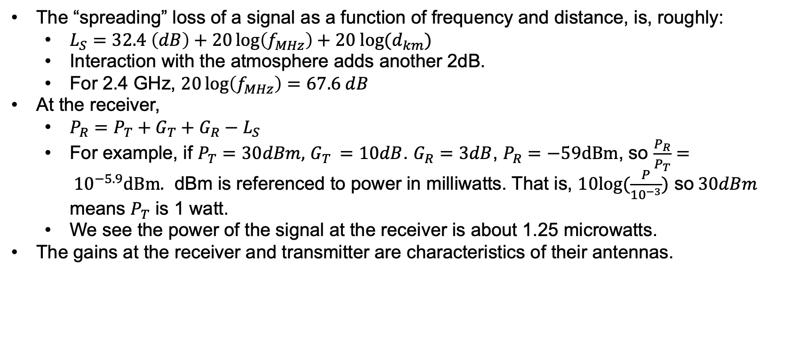
Signal loss
The “spreading” loss of a signal as a function of frequency and distance, is, roughly:
$L_{S}=32.4 \left(dB\right)+20\log\left(f_{MHz}\right)+20 log⁡(d_{km})$
Interaction with the atmosphere adds another 2dB.
For 2.4 GHz, $20\log\left(f_{MHz}\right)=67.6 dB$
At the receiver,
$P_{R}=P_{T}+G_{T}+G_{R}−L_{S}$
For example, if $P_{T}=30dBm,$ $G_{T }=10dB$. $G_{R}=3dB$, $P_{R}=−59dBm$, so $\frac{P_{R}}{P_{T}}= {10}^{−5.9}dBm.$ dBm is referenced to power in milliwatts. That is, $10log⁡(\frac{P}{{10}^{−3}})$ so$30dBm$ means $P_{T}$ is 1 watt.
We see the power of the signal at the receiver is about 1.25 microwatts.
The gains at the receiver and transmitter are characteristics of their antennas.

Slide 41
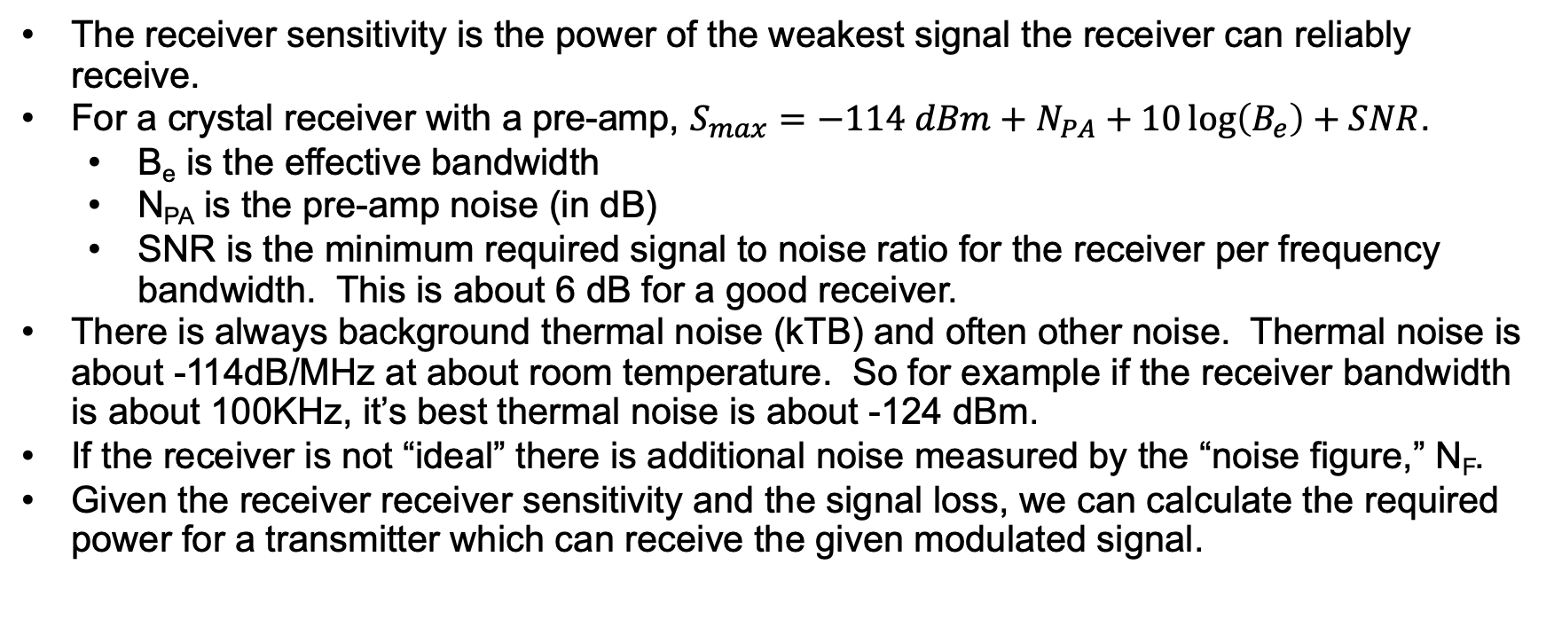
Receiver sensitivity
The receiver sensitivity is the power of the weakest signal the receiver can reliably receive.
For a crystal receiver with a pre-amp, $S_{max}=−114 dBm+N_{PA}+10\log\left(B_{e}\right)+SNR$.
B_{e} is the effective bandwidth
N_{PA} is the pre-amp noise (in dB)
SNR is the minimum required signal to noise ratio for the receiver per frequency bandwidth. This is about 6 dB for a good receiver.
There is always background thermal noise (kTB) and often other noise. Thermal noise is about -114dB/MHz at about room temperature. So for example if the receiver bandwidth is about 100KHz, it’s best thermal noise is about -124 dBm.
If the receiver is not “ideal” there is additional noise measured by the “noise figure,” N_{F}.
Given the receiver receiver sensitivity and the signal loss, we can calculate the required power for a transmitter which can receive the given modulated signal.

Slide 42
Jamming
Jamming seeks to interfere with an intended signal by presenting a higher power signal at the location of the receiver.
Jammers may try to completely prevent reception or modify received signals. GPS deception is an example of signal modification.
Power is a critical characteristic in jamming a receiver and efficient steering of available power.
There are several anti-jamming techniques: spread spectrum and frequency hopping can be employed to prevent an prospective jammer from targeting a frequency range.
Receivers can try to use antenna directionality to preferentially receive signals from a particular direction.
With 802.11, use of encryption and cryptographic integrity protection can lessen the impact of eavesdropping; however, routing and destination is still visible in most schemes. If you encrypt, you’d better do key management correctly.

Slide 43
Jamming ODFM
The critical factor in jamming is the power at the receiver passband(s). This depends on the geometry of the jammer transmission(s), the real transmitters(s) and the receiver as well as their power. These together with the frequency determines the jamming effectiveness.
Recall ODFM has multiple channels encoding the signal and we need to jam enough of them to interfere with communications.
By the way, if we present a jamming signal of significantly more power, we may be able to introduce a “false signal” and take over the channel rather than merely blocking it.

Slide 44
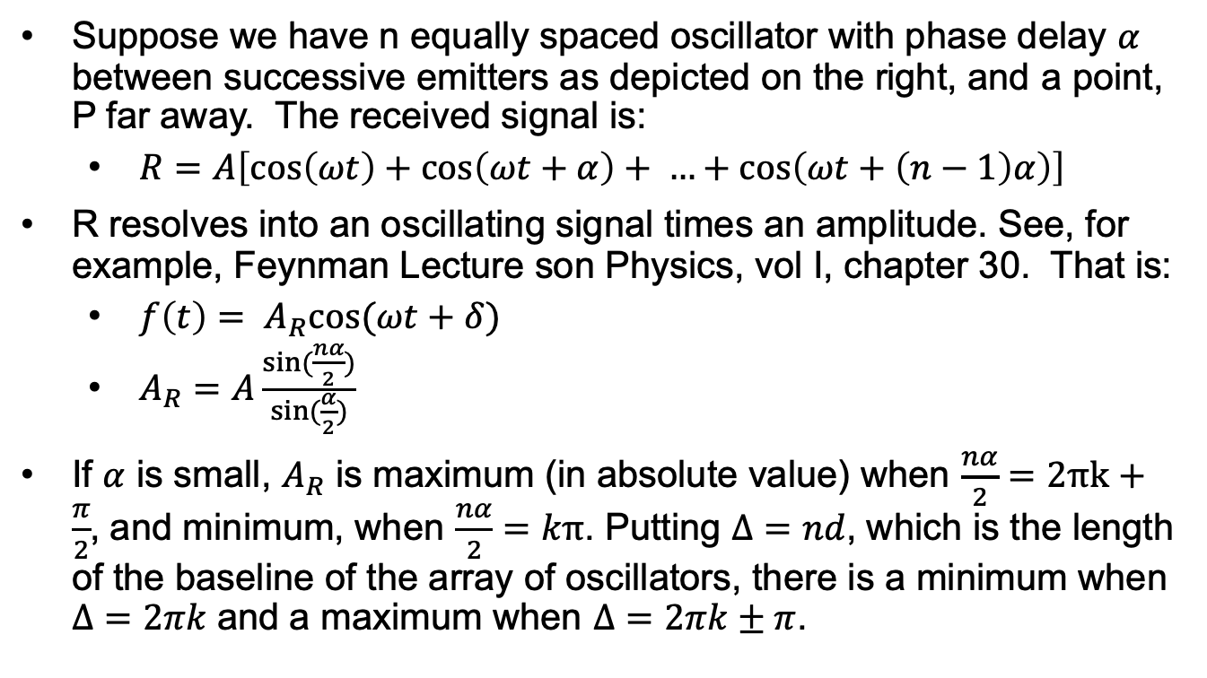
Array of coherent sources
Suppose we have n equally spaced oscillator with phase delay $α$ between successive emitters as depicted on the right, and a point, P far away. The received signal is:
$R=A\left[\cos\left(ωt\right)+\cos\left(ωt+α\right)+ …+\cos\left(ωt+\left(n−1\right)α\right)\right]$
R resolves into an oscillating signal times an amplitude. See, for example, Feynman Lecture son Physics, vol I, chapter 30. That is:
${f\left(t\right)= A}_{R}cos⁡(ωt+δ)$
$A_{R}=A\frac{sin⁡(\frac{nα}{2})}{sin⁡(\frac{α}{2})}$
If $α$ is small, $A_{R}$ is maximum (in absolute value) when $\frac{nα}{2}=2πk+\frac{π}{2}$, and minimum, when $\frac{nα}{2}=kπ$. Putting $Δ=nd$, which is the length of the baseline of the array of oscillators, there is a minimum when $Δ=2πk$ and a maximum when $Δ=2πk±π$.
P (far away)
…
d

Slide 45
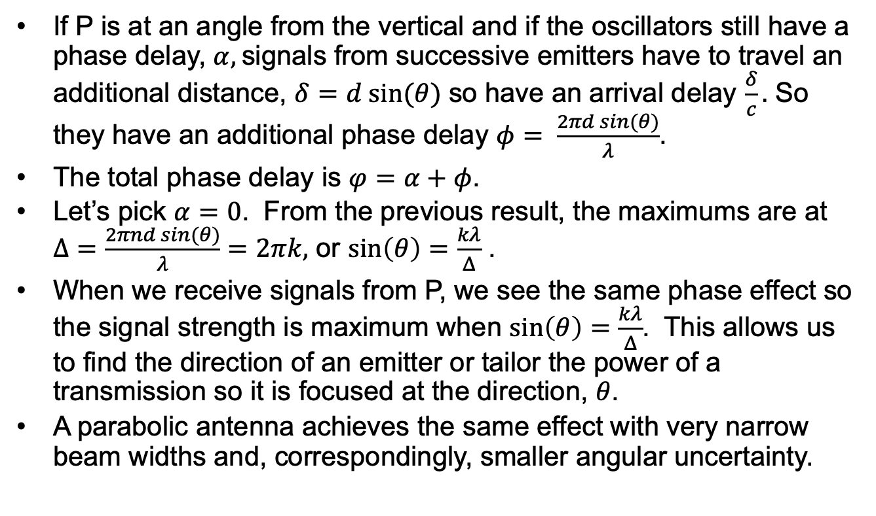
Beam forming and reception with multiple elements
P (far away)
If P is at an angle from the vertical and if the oscillators still have a phase delay, $α,$signals from successive emitters have to travel an additional distance, $δ=d sin⁡(θ)$ so have an arrival delay $\frac{δ}{c}.$ So they have an additional phase delay $φ= \frac{2πd sin(θ)}{λ}$.
The total phase delay is $φ=α+φ$.
Let’s pick $α=0$. From the previous result, the maximums are at $Δ=\frac{2πnd sin⁡(θ)}{λ}=2πk,$ or $sin\left(θ\right)=\frac{kλ}{Δ}$ .
When we receive signals from P, we see the same phase effect so the signal strength is maximum when $sin\left(θ\right)=\frac{kλ}{Δ}$. This allows us to find the direction of an emitter or tailor the power of a transmission so it is focused at the direction, $θ$.
A parabolic antenna achieves the same effect with very narrow beam widths and, correspondingly, smaller angular uncertainty.
𝜃
…
𝛿
d

Slide 46
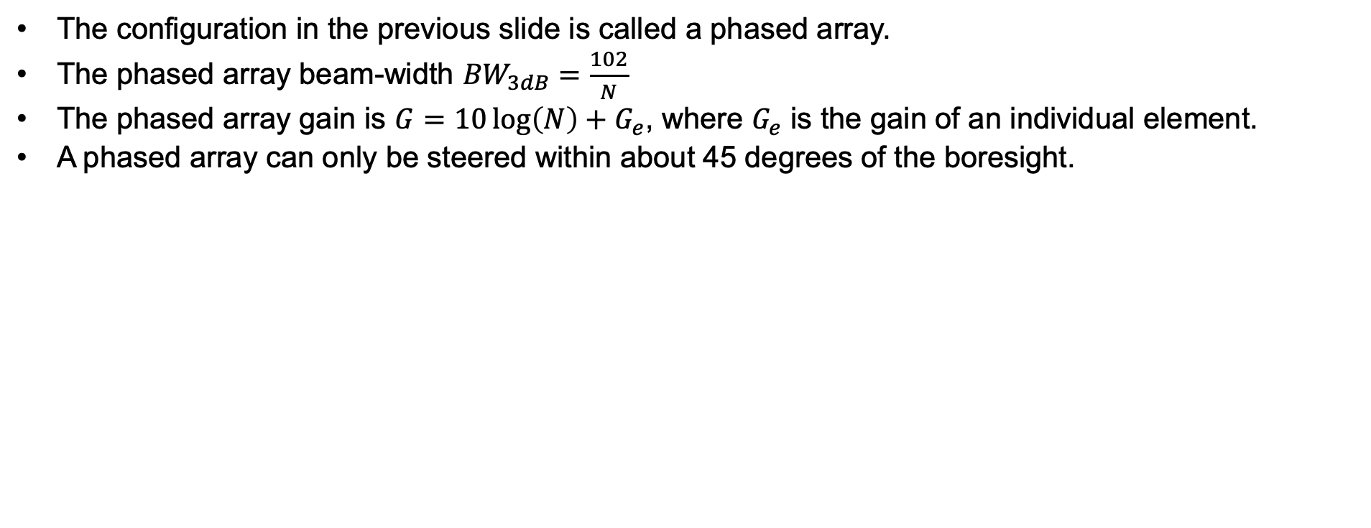
Additional information on phased arrays
The configuration in the previous slide is called a phased array.
The phased array beam-width ${BW}_{3dB}=\frac{102}{N}$
The phased array gain is $G=10\log\left(N\right)+G_{e}$, where $G_{e}$ is the gain of an individual element.
A phased array can only be steered within about 45 degrees of the boresight.

Slide 47
Broad band amplifiers
Most SDR’s have low output power.
You can buy broad band amplifiers to boost signal strength, see here and here.
Remember to make sure emissions remain within regulatory limits or are done in a Faraday cage.

Slide 48
SDR and IoT
SDR’s have become very cheap and processors (and FPGA’s) that run at high enough clock rates to do real time signal processing are now generally available.
We will use a HackRF One SDR, which samples signals in the band 1MHz to 6 GHz and sends the digital time series to a computer through a USB connection. It also takes digital time series data and synthesizes transmission waves.
We will write programs to process and generate signals. For example, we can transmit and receive 802.11 wireless signals, demodulate them and process the encoded data with an SDR.
We and also “jam” or “spoof” such signals with the SDR.

Slide 49
Follow the rules
You can receive and decode anything you want but the FCC regulates transmission over most of the radio spectrum. In unlicensed spectrum, transmission power is limited to .25 watts of power.
If you get a “ham” license, much more spectrum is available and much higher power can be used.
Hams have community repeaters and operate satellites.
Toys and remote controllers use frequencies around 433 MHz.
Radars use much higher frequencies. X-band radar (a common variant) operates at 8-12 GHz.
You can use a spectrum analyzer to detect frequency emissions of cars, fobs wireless entry systems, etc.
There’s a lot more out there.

Slide 50
Exercises
Build an FM detector from and SDR using GNU Radio
Intercept 802.11, BLE, Zigbee communication and log it.
Use 3 SDR's to jam a low power 802.11 transmitter.
Develop a GNU based SDR decoder to capture (unencrypted) airplane routing information.
Calculate the power needed to effectively jam IoT reception via wireless.
How many standard SDR's (or sdr's with standard amps) would you need? What is the area of effect?
Can you glitch IoT wireless communications with standard protocols? Are there any protocols that are resilient to this?
Can you apply RF to interfere with IoT performance? Is there an analogy with software fuzzing?
Reverse engineer and jam/interpose wireless weather station protocol
Reverse engineer and jam/interpose wireless car based protocol

Slide 51
References
Michael Ossmann, https://greatscottgadgets.com/hackrf/ (Tutorial)
GNU Radio
ARRL Handbook
Petrich and MacDermott, Digital signal processing and GNU radio
Bloess, Segata, Sommer and Dressler, An IEEE 802.11a/g/p OFDM Receiver for GNU Radio
Adamy, Electronic Warfare 101
SDR for the masses

Slide 52
License
This material is licensed under Apache License, Version 2.0, January 2004.
Use, duplication or distribution of this material is subject to this license and any such use, duplication or distribution constitutes consent to license terms.
You can find the full text of the license at: http://www.apache.org/licenses/.

Slide 53
Beam forming 802.11 protocol stack

Slide 54
Mac frame format

Slide 55
OFDM integration

Slide 56
Radio and SDR
Radios and transmission of EM waves.
Propagation
Modulation (OFDM, BPSK ...)
Digital signal processing
SDR’s
GNU radio
Electronic warfare: jamming, spread spectrum
SDR’s: HackRF One, Ettus USRP

